Slide 1
Energy Efficiency Final Project
Group - 8
Vedant Murudkar - 286557233
Krishna Tiwari - 860871188
Shweta Khopde - 317281596
Mahima Jayanth - 362401553
Sai Roshan Varma - 311126543

Slide 2
Dataset Description
Our Dataset contains data on the energy efficiency of buildings. This dataset includes 8 inputs and two outputs. They are:
Relative Compactness (RC) - This is the ratio of the building's volume to its surface area.
Surface Area (SA) - This is the total surface area of the building.
Wall Area (WA) - This is the total area of the walls in the building.
Roof Area (RA) - This is the total area of the roof in the building.
Overall Height (OH) - This is the height of the building.
Orientation - This is the building's orientation (i.e., its direction relative to true North).
Glazing Area (GA) - This is the total area of the windows in the building.
Glazing Area Distribution (GAD) - This is the distribution of the glazing area across the building.
The two target variables in the dataset are:
Heating Load (HL) - This is the amount of heating required to maintain a comfortable indoor temperature.
Cooling Load (CL) - This is the amount of cooling required to maintain a comfortable indoor temperature.

Slide 3
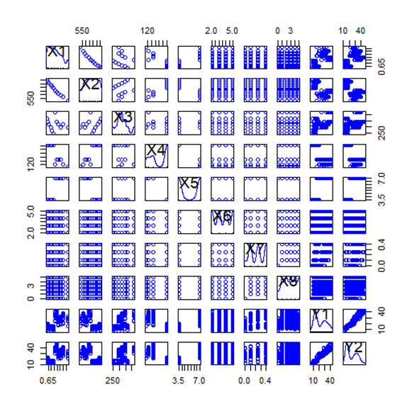
Visualization
The scatterplot represents the relationship between heating Load(HL) and Cooling Load(CL) with all independent variables.

Slide 4
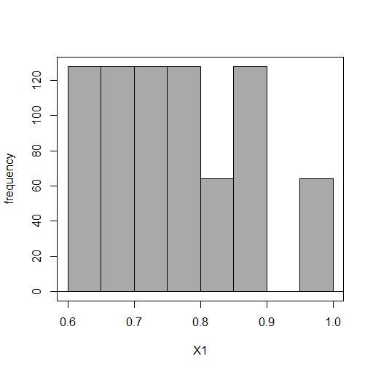
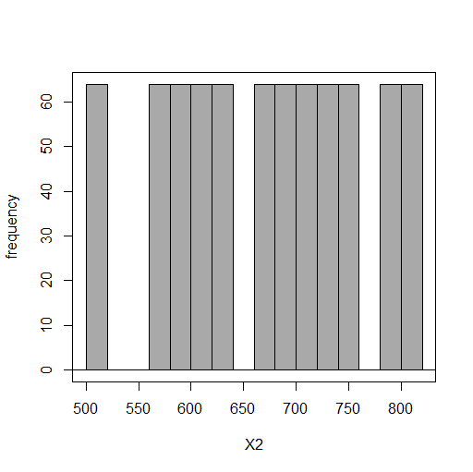
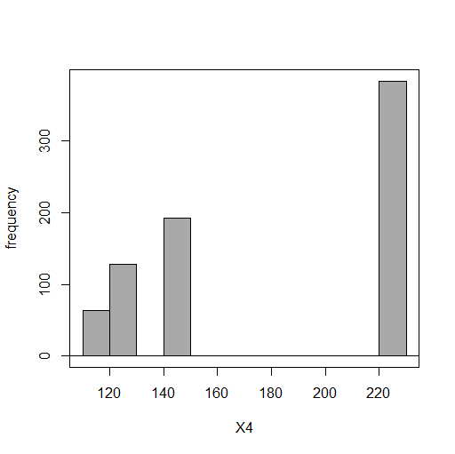
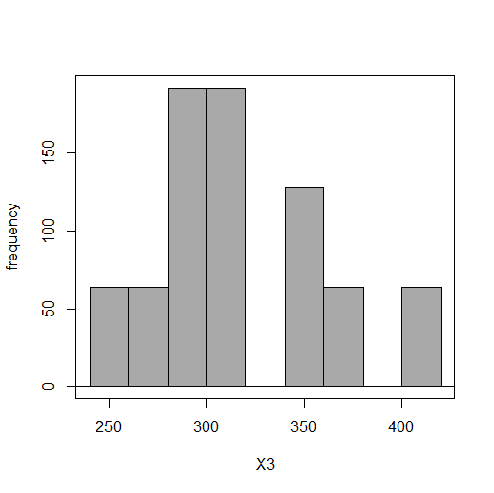
Visualization- Histograms
X1 Relative Compactness
Average relative compactness is 0.764.
X2 Surface Area
X4 Roof Area
X3 Wall Area

Slide 5
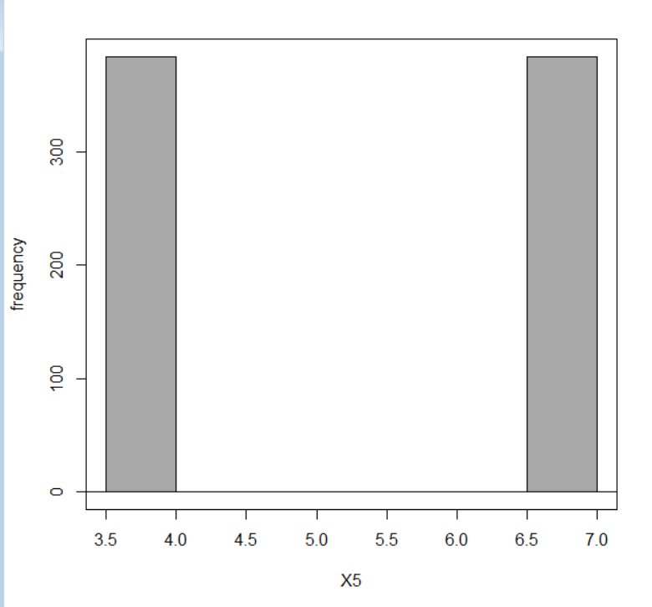
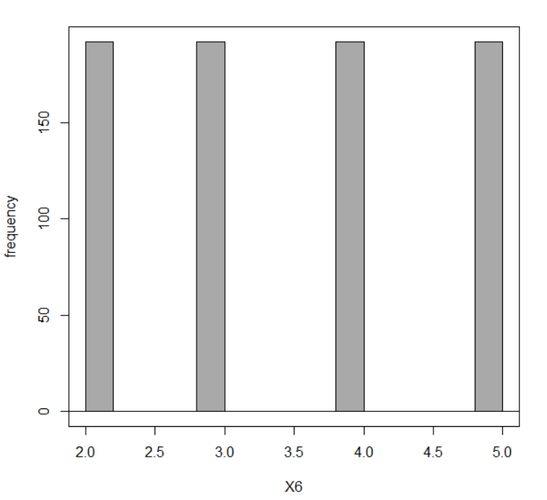
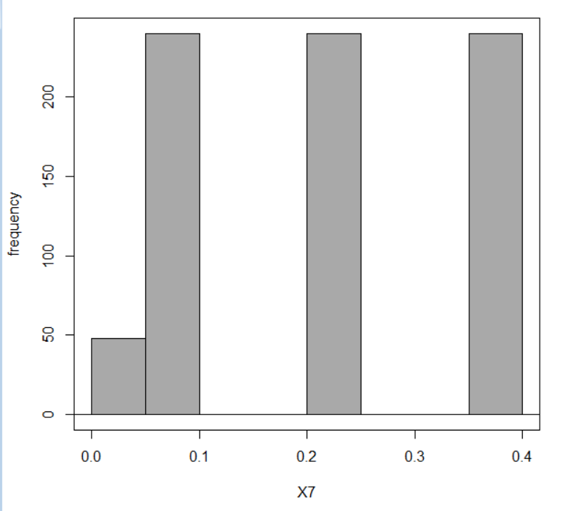
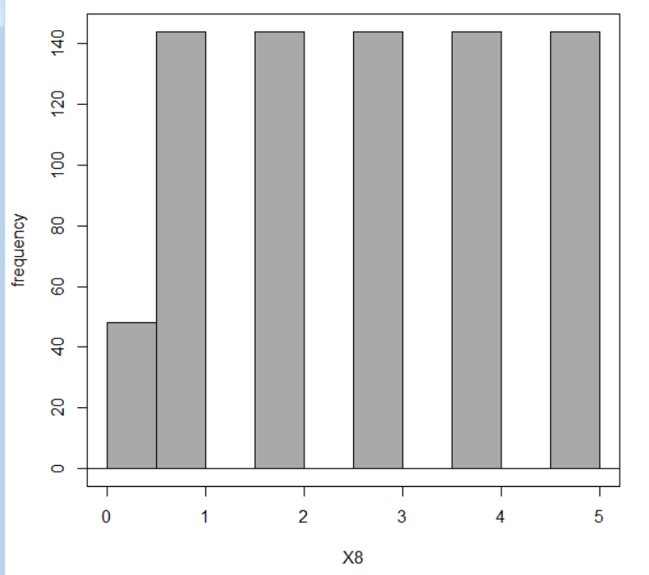
X5 Overall Height
The higher building height, it'll increase facade area and exposure to the outside also will increase.
X6 Orientation
X8 Glazing Area Distribution
(1=Uniform,2=North, 3=East, 4=South, 5=West)
X7 Glazing Area
The average Glazing area is 0.23

Slide 6
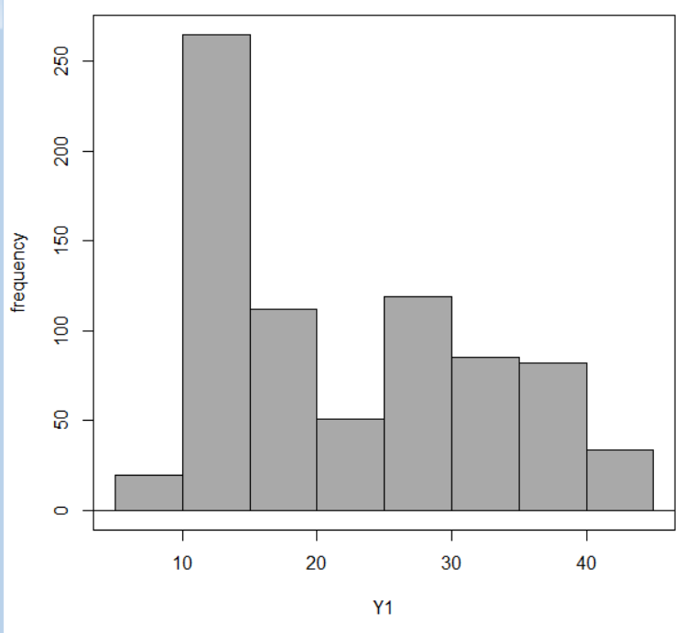
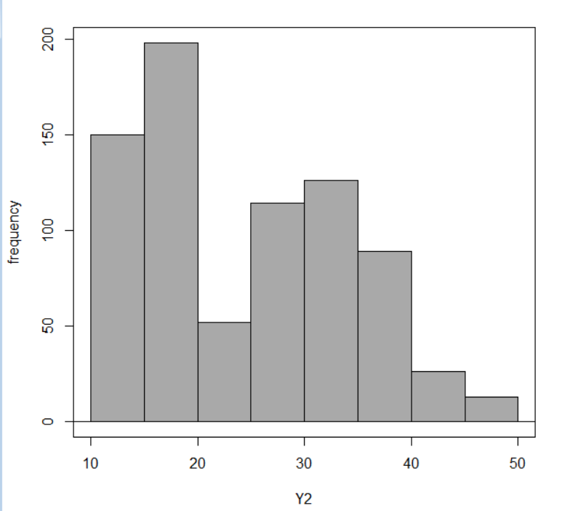
Histograms for Output Variables
Heat Load
Cool Load

Slide 7
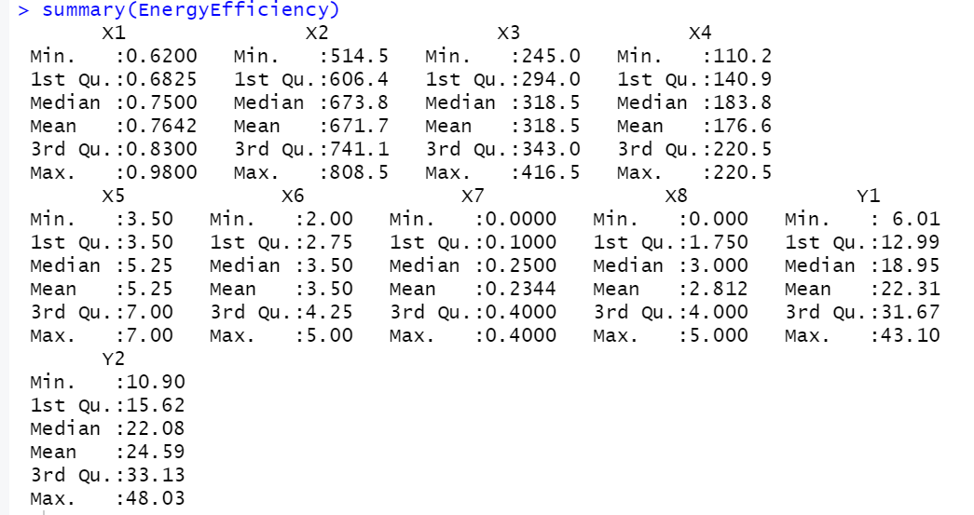
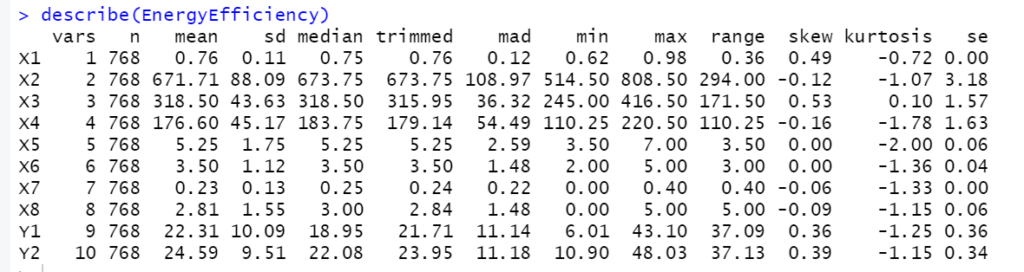
Statistical Analysis
Descriptive Statistics is used to describe and summarize the characteristics of a set of data.
It involves analyzing, organizing, and presenting data in a way that can be easily understood.
The summary() function is often used as a quick way to get an overview of a dataset.
Describe() is a function in the psych package that provides a more detailed summary of the data, including measures of central tendency, skewness, and kurtosis, se.
Each feature has a different scale, as we can see the minimum and maximum values for each of the variables. To obtain a better scale, it is good to normalize the data because it makes distributions better.

Slide 8
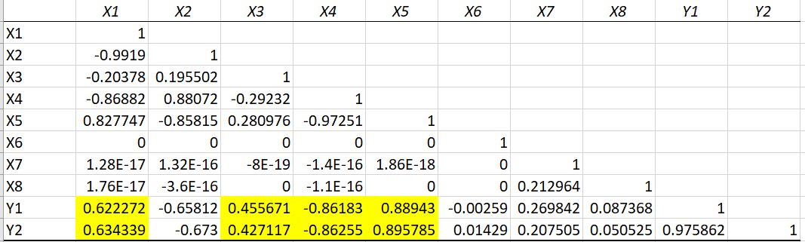
Correlation Matrix
We observe X1(Relative Compactness), X3(Wall Area), X5(Overall Height) are positively correlated with Y1(heating) and Y2(cooling load)
whereas X4(Roof Area) is negatively correlated with Y1(heating) and Y2(cooling load)

Slide 9
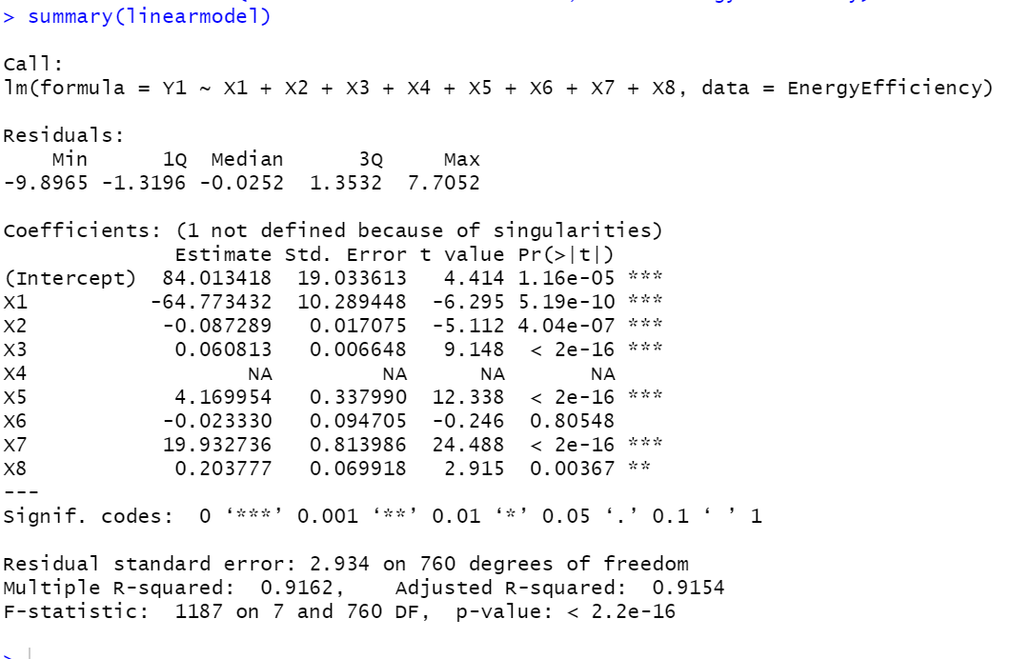
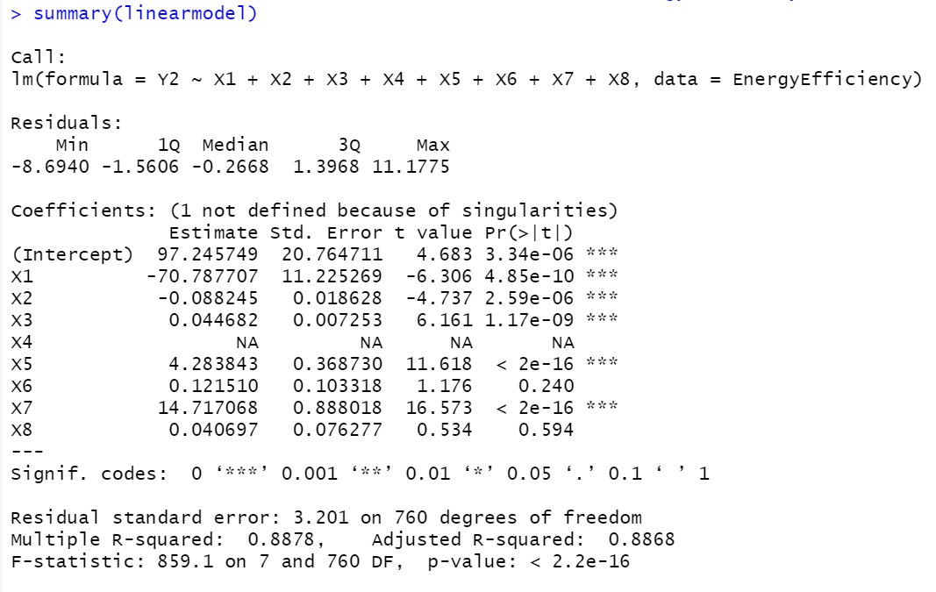
Linear Regression
X1, X2,X3,X5,X7,X8 are significant So, we should consider these variables for model training
We observe similar patterns only X8 is not significant along with X4 and X6 here

Slide 10
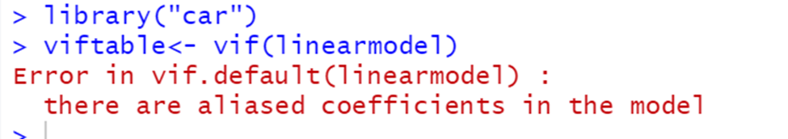
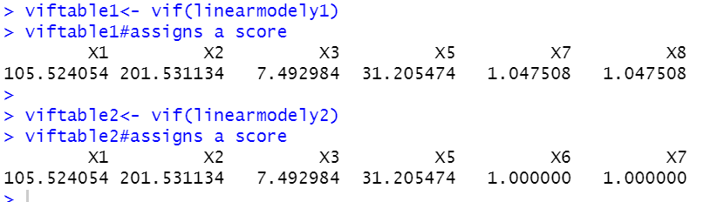
VIF
VIF-is a measure of multicollinearity among the predictor variables in a linear regression model.
Aliased coefficients refer to the situation in a linear regression model where two or more predictor variables are perfectly linearly related to each other.
In a linear regression model with aliased coefficients, the regression coefficients of the predictor variables cannot be estimated uniquely. This is because the linear regression model tries to estimate the effect of each predictor variable on the response variable while holding all other variables constant, but in the presence of aliased coefficients, this is not possible because the variables are not independent

Slide 11
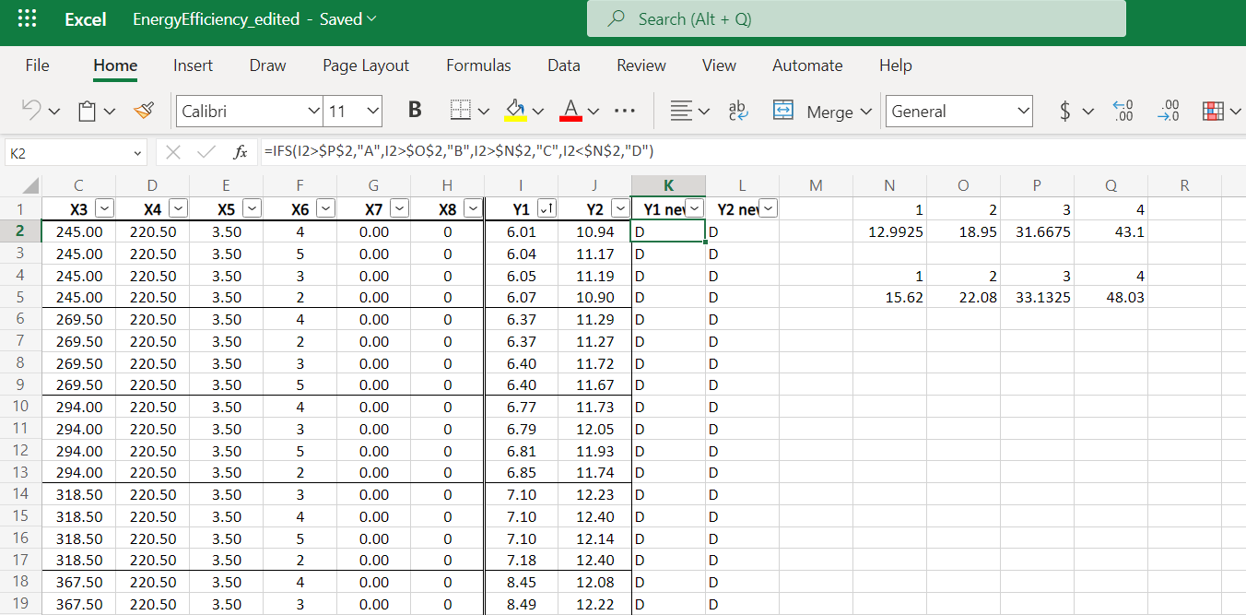
Assigned categories according to Quartile in Excel

Slide 12
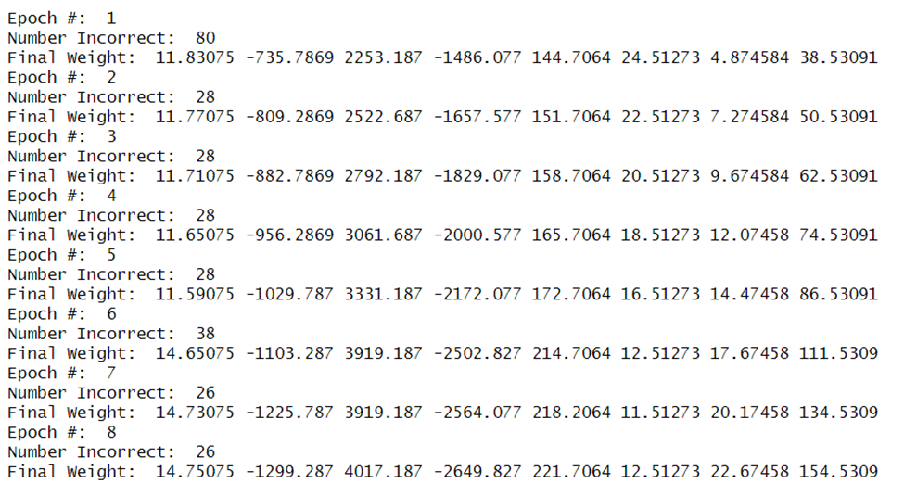
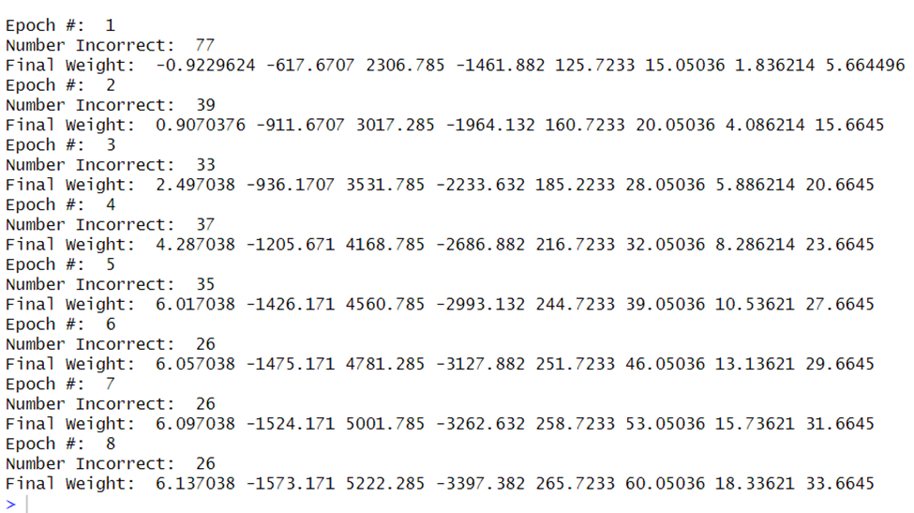
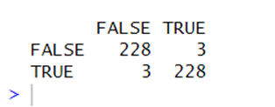

Perceptron
A perceptron is a type of classification algorithm in machine learning that is used to classify input data into one of two classes.
Y1 with all X Variables
Y2 with all X Variables

Slide 13
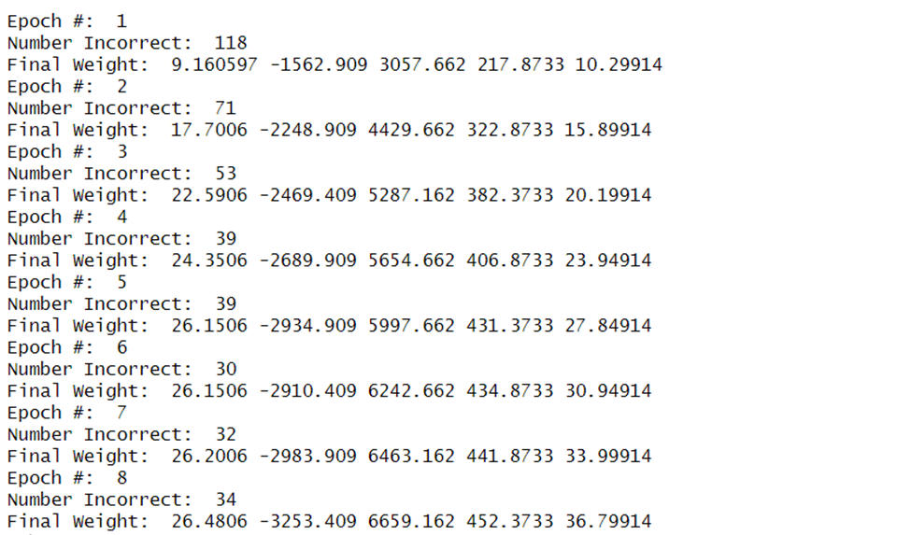
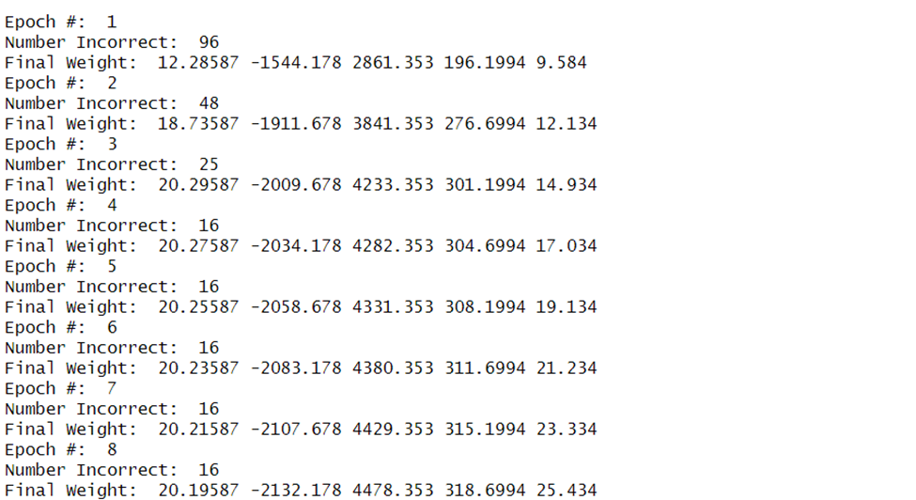
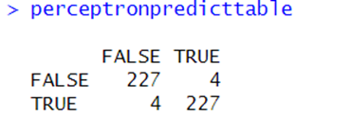


Y1 with Significant variables
Y2 with Significant Variables
Perceptron Model Execution gives slightly better accuracy with Significant Variables.

Slide 14
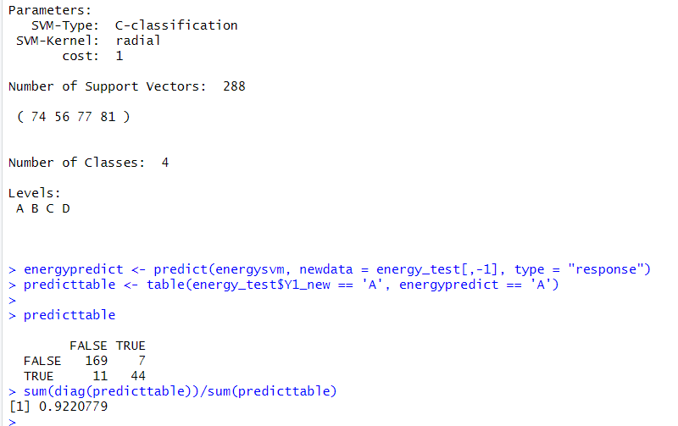
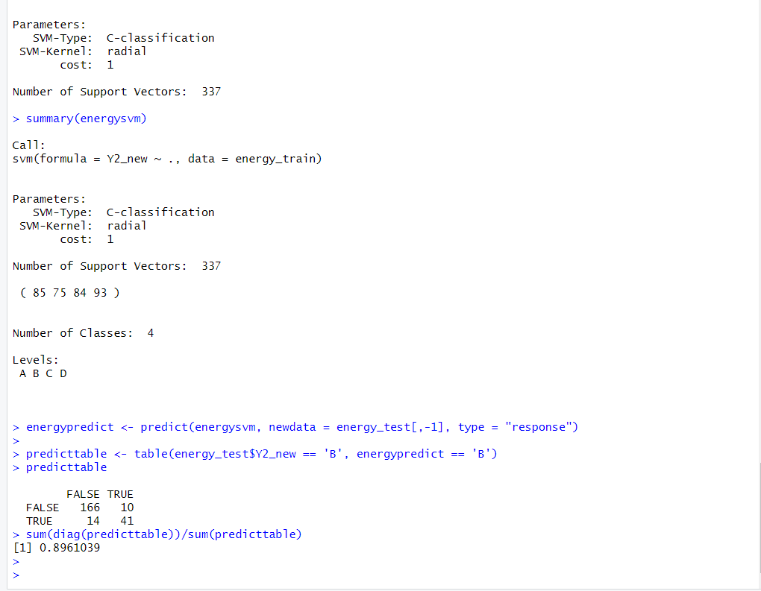
Support Vector Machine
All variables and Y1_new, Accuracy = 92%
All variables and Y2_new , Accuracy = 89%
SVM can be used for both binary and multi-class classification tasks as well as regression tasks. It is commonly used in applications such as text classification, image classification, and bioinformatics.
The goal of SVM classification is to divide the data points into two or more classes based on their features.

Slide 15
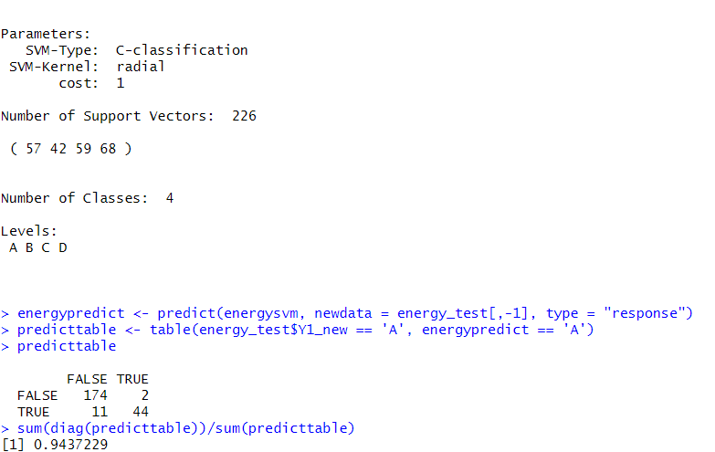
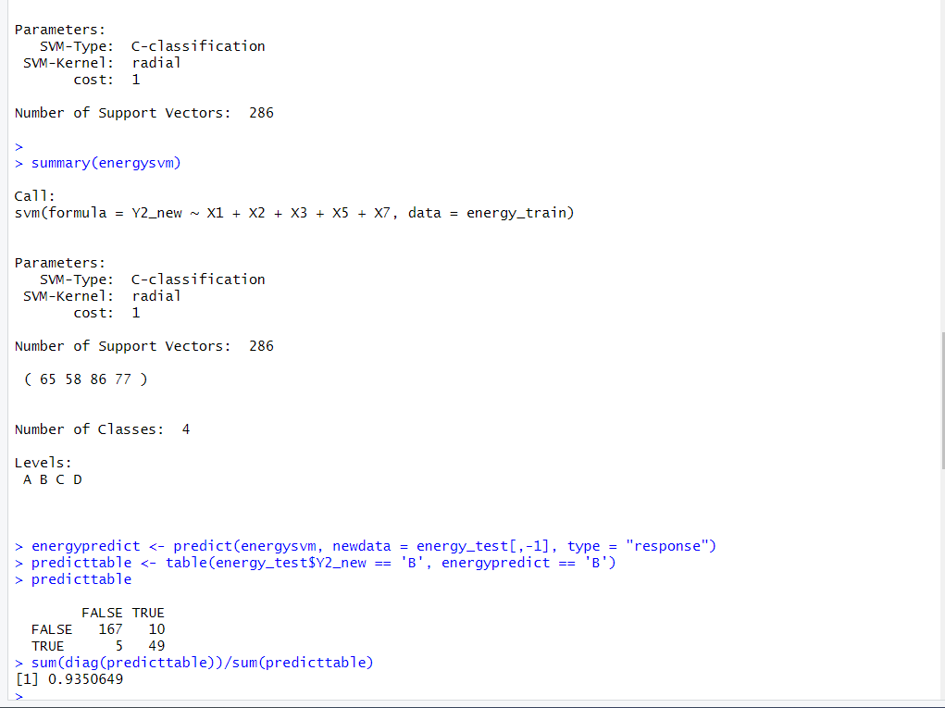
Support Vector Machine
Variables 1,2,3,5,7 and Y1_new , Accuracy = 94 %
Variables 1,2,3,5,7 and Y2_new = Accuracy = 93%
SVM Model Execution gives slightly better accuracy with Significant Variables.

Slide 16
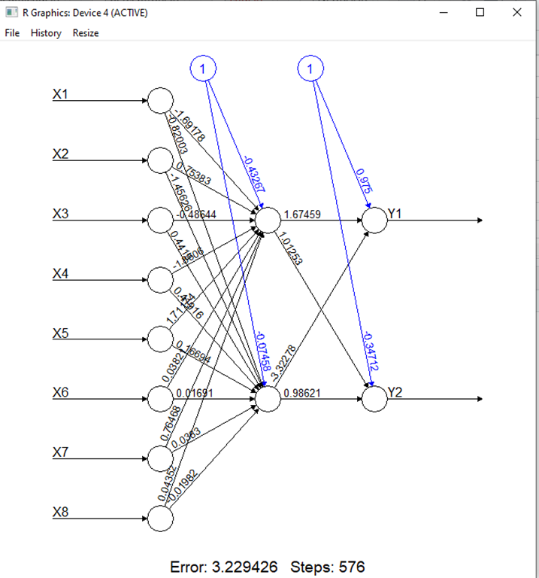
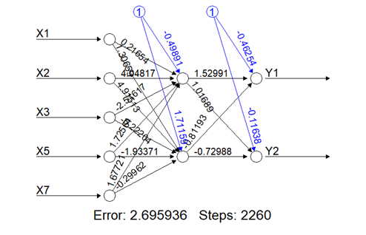
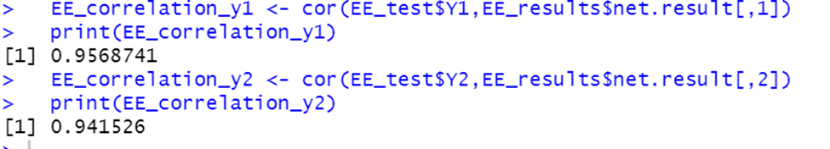
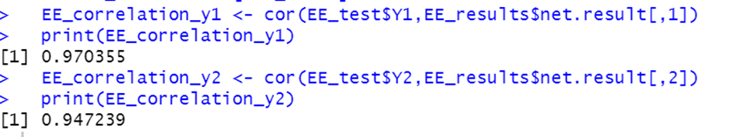
Neural Networks
NN with 8 inputs , 1 hidden layer with 2 nodes and 2 outputs
NN with 5 inputs , 1 hidden layer with 2 nodes and 2 outputs

Slide 17
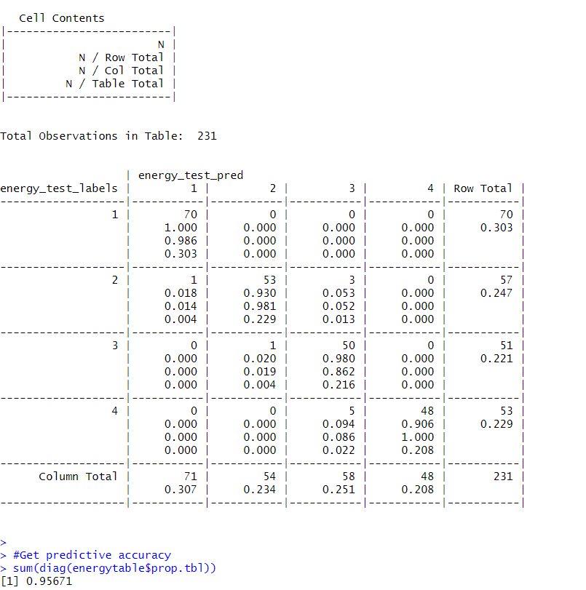
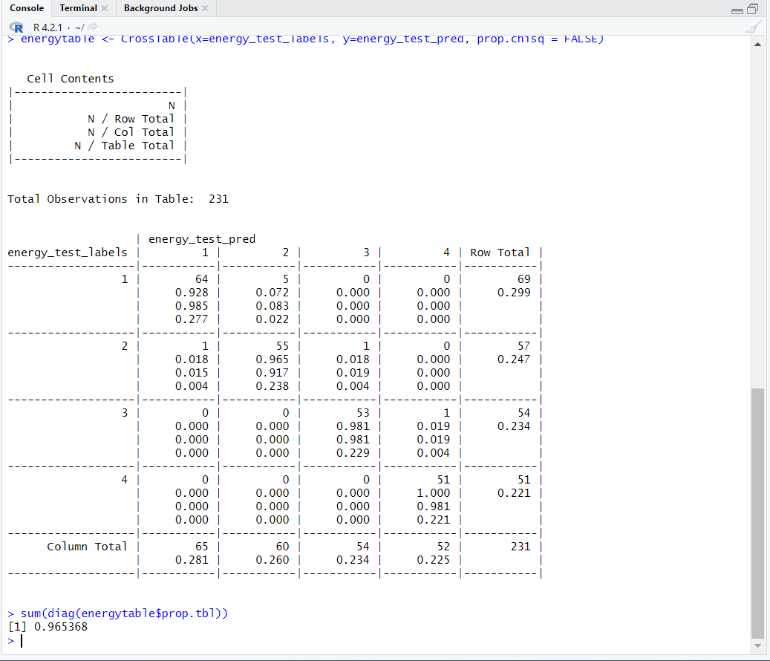
K – Nearest Neighbor
The k-nearest neighbor (k-NN) approach is a clustering method that employs the k nearest data points in proximity to a new data point for grouping it into a category.
The k-NN algorithm utilizes labeled training data to understand how to classify the data points into different categories.
Variables 1,2,3,5,7 and Y2_num , Accuracy = 96%
Variables 1,2,3,5,7 and Y1_num
Accuracy = 95%

Slide 18
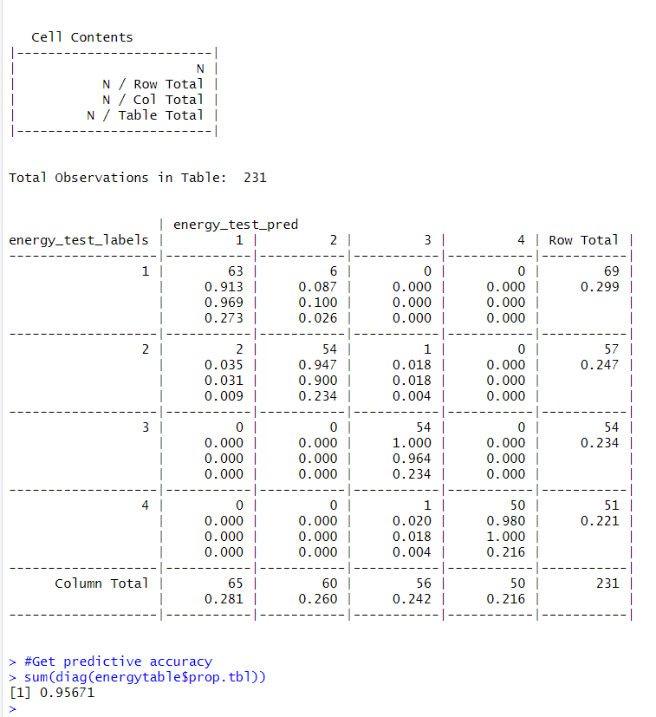
K – Nearest Neighbor
All variables and Y1_num , Accuracy = 96%
All variables and Y2_num , Accuracy = 95%

Slide 19


Naïve Bayes
Naïve Bayes is a clustering technique algorithm in machine learning to help computers learn how to classify things.
The algorithm calculates the probability of a data point belonging to a particular class by computing the conditional probability of each feature given the class
In Naive Bayes, the key assumption is that all features are independent of each other, meaning that the presence of one feature does not affect the probability of another feature.
This simplifies the calculations and makes the algorithm fast and efficient.
Variables 1,2,3,5,7 and Y1_num
Accuracy = 54%
Variables 1,2,3,5,7 and Y2_num
Accuracy = 51%

Slide 20
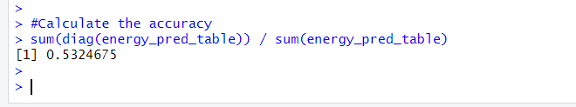
Naïve Bayes
All variables and Y1_num
Accuracy = 53%
All variables and Y2_num
Accuracy = 51%

Slide 21
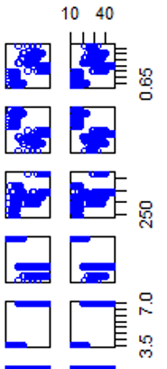
Lessons Learnt
Perceptron(98.2%) and neural network(97%) gave us highest accuracy
One reason why the perceptron may give high accuracy is that our dataset may have a linearly separable structure.
This means that the data can be separated into two classes using a straight line or a hyperplane in the feature space.
Since the perceptron algorithm tries to find the optimal hyperplane that separates the data, it can achieve high accuracy than other models

Slide 22
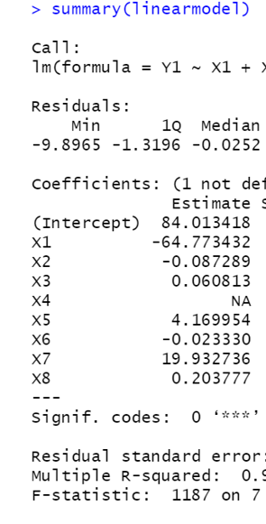
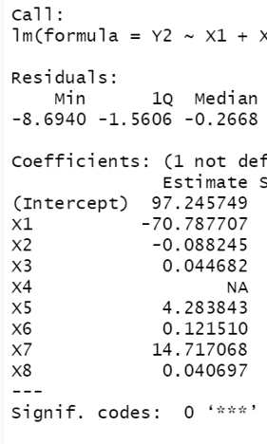
Insights for builders of energy efficient buildings
X1 , X2 have negative coefficients so we will have to increase their coefficients in-order to reduce heating load
Whereas X3 ,X5, X7,X8 have positive coefficients so we will have to decrease them in-order to reduce heating load
Hence the builders should focus on increasing the Relative Compactness and Surface area
and reduce wall area , overall height and glazing area of the building to decrease the heating and cooling load respectively
Here are some additional insights -
Monitor and analyze energy usage
Utilize renewable energy sources
Implement energy-efficient lighting
Control ventilation and air quality

Slide 23
Thank You
We hope you found our machine learning model useful.
If not,
we blame the "Data".

